Slide 1
Lactobacilli with its impact in oral cavity
Lecturer Reham M.M. AL-Mosawi
Medical Microbiology (Bacteriology)
Lec.Part 1

Slide 2
Lactobacilli characteristics
Gram-positive , non-spore forming , some strians are non-motile while afew strians are motile by peritrichous flagella, nonpigmented ,facultative anaerobic or microaerophilic , these are straight or curved rods that , like corynebacteria , frequently show bipolar bodies due to the presence of metachromatic granules that give the rod a beaded appearance. which are commonly isolated from the oral cavity.
The catalase test negative

Slide 3
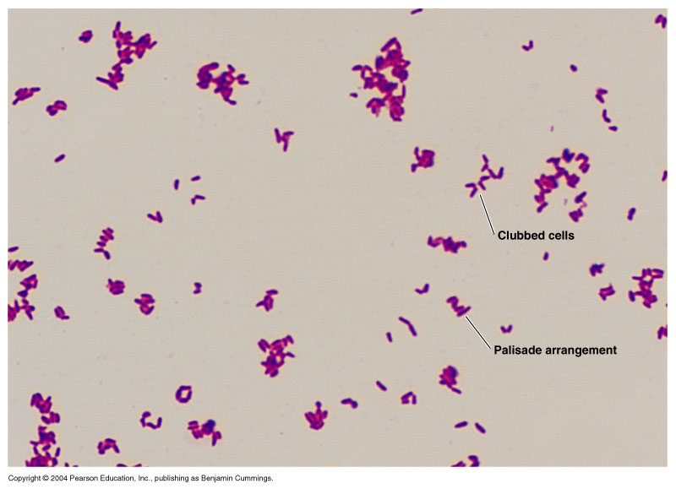
Corynebacterium

Slide 4
Lactobacillus
Gram +ve bacilli , alpha or non hemolytic.
L. casei, L. rhamnosus, L. acidophilus, L. oris
Ferment carbohydrates to form acids (acidogenic)
Tolerate acid (aciduric)
Major members of the normal flora of the vagina. The lactic acid product of their (Lactobacillus.spp) metabolism helps to maintain the low pH of the normal female genital tract that inhibits the growth of pathogens . Rarely cause disease
Lactobacilli in the oral cavity probably contribute to acid formation that leads to dental caries.
Cariogenic, highly acidogenic organisms, and not early work implicated of lactobacilli in the initiation of dental caries.

Slide 12
Recently we can using the modified media MRS agar or broth by addition of 0.05% cysteine to improve the specificity of this medium for isolating of Lactobacilli.spp with pH of media adjusted to 6.5.

Slide 13
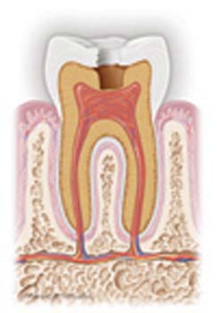
Pathogenesis of Lactobacilli In the mouth , they have been incriminated in the pathogenesis of dental caries. Dental caries
Caries is an infectious transmissible disease resulting from tooth
adherent bacteria that metabolize sugars to produce acid which
ultimately demineralize tooth structure and, if left untreated, can
progress to a cavity.
Caries
Teeth
Bacteria
Time
Carbohydrate
Notes:
Glossary:
Cavity: An area of decay in a tooth

